Slide 1
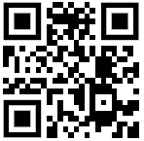
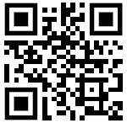
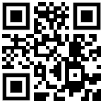
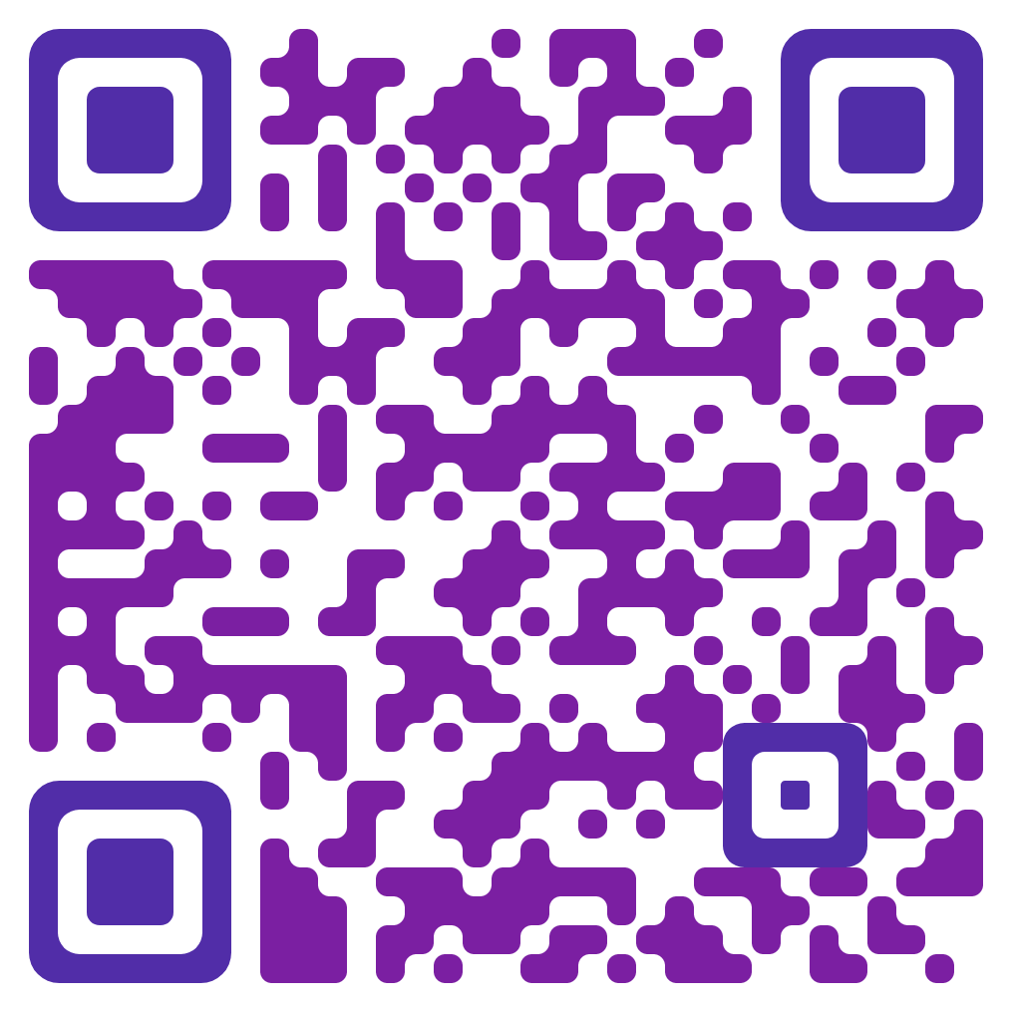
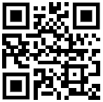
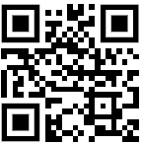
T
I
T
L
E
I
1.
at Abingdon
2
96% of teachers are highly qualified, effective teachers Parents have a right to know about their child’s teachers’ qualifications
Success measured by: achievement & growth in math & reading state test scores English Learner progress school absenteeism Abingdon School Quality Profile
Title I funds: literacy coaches and math interventionists additional classroom materials, books, & intervention materials to support instruction the Summer Mailbox Book Program
Title I funds: Responsive Classroom training professional book studies instructional workshops curriculum work
opportunities for families to get involved funds family engagement activities Partner with: Rosie Riveters, Toys for Tots, Arlington Sports Foundation
Qualified, Effective Teachers
High Academic Standards
3
4
Additional Instructional Support & Interventions
Professional Development
5
6
Family Engagement
& Community Partnerships

